Slide 1

Dynamic modeling and control of a system of electrolyzers for hydrogen production
16.12.2019
forward my sincere gratitude to the supervisors
Md Rizwan

Slide 2
Outline
Motivation and Introduction
Process flowsheet
Dynamic simulation results
Control study: Design of regulatory control layer
Conclusion and future work

Slide 3
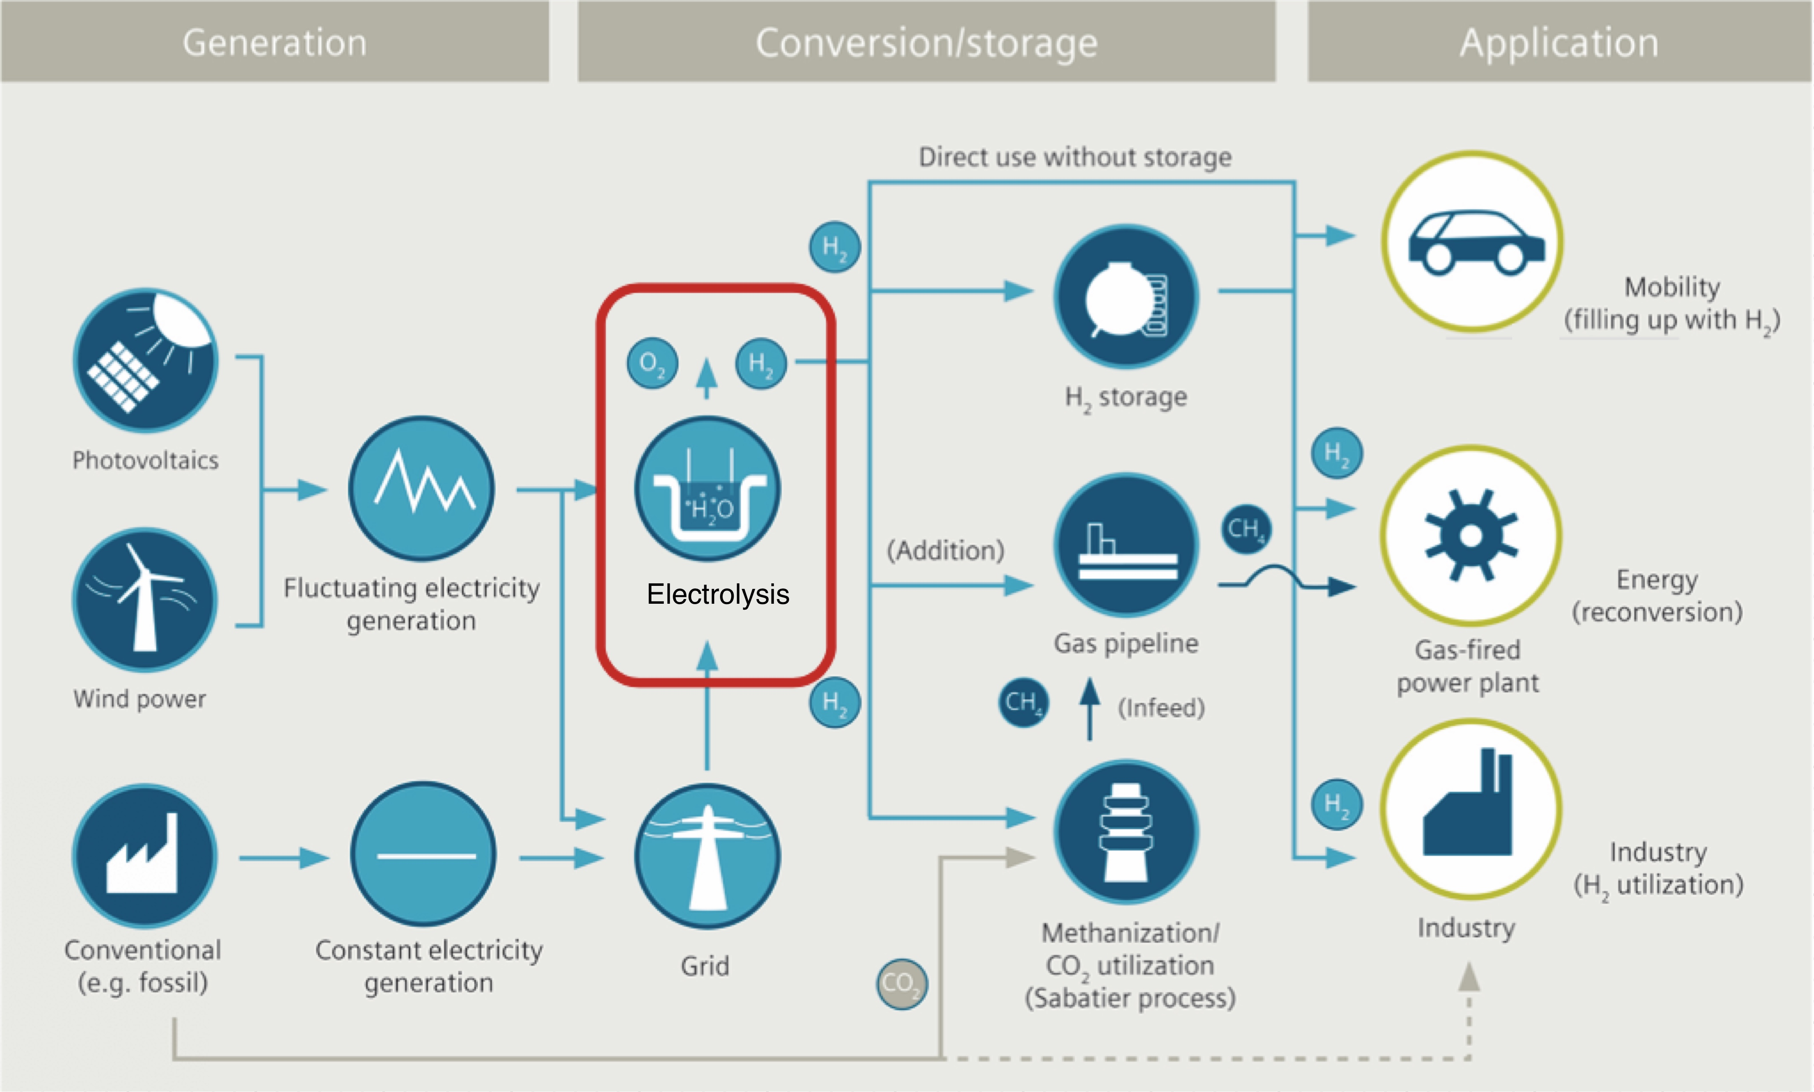

Why green hydrogen for ammonia production?
Motivation
$$N_{2}+3H_{2}→2NH_{3}$$
Green hydrogen enables to reduce carbon footprint of the fertilizer industry
©Siemens AG 2015 All rights reserved
Notes:
What is role of ammonia in fertilizer production?
How ammonia is produced?(Process, temp and pressure conditions)
Conventional source of hydrogen
Contribution of fertilizer industry to GHG emission? Around 1.5%
Water electrolysis as a way for hydrogen production
What is electrolysis and which gas is released at cathode and anode
Methods for electrolysis
Why AEL
Why we need control for electrolyzer? Because we need higher efficiencies of overall system when supplied with intermittent power

Slide 4
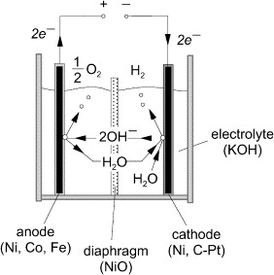
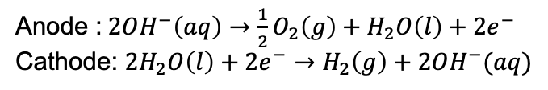
Theory: Alkaline water Electrolyzer
Anode :$2OH^{−}\left(aq\right)→\frac{1}{2}O_{2}\left(g\right)+H_{2}O\left(l\right)+2e^{−}$
Cathode: $2H_{2}O\left(l\right)+2e^{−}→H_{2}\left(g\right)+2OH^{−}(aq)$
Figure: Ulleberg, International Journal of Hydrogen Energy (2003)
Notes:
Cathode and anode reactions eqns in an electrolyzer cell

Slide 5


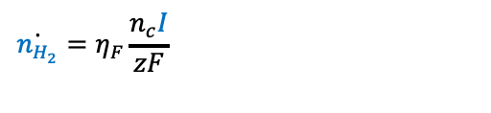
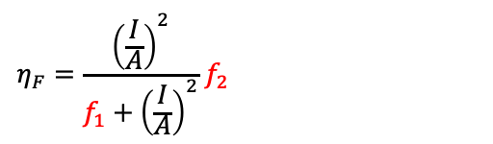
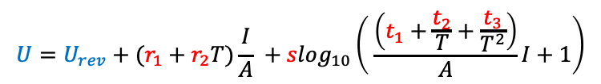
Theory: Alkaline water Electrolyzer
$$U=U_{rev}+(r_{1}+r_{2}T)\frac{I}{A} +slog_{10}\left( \frac{\left(t_{1}+\frac{t_{2}}{T}+\frac{t_{3}}{T^{2}}\right)}{A}I+1\right)$$
$$U_{ohm}$$
$$U_{act}$$
$$η_{F}=\frac{{\left(\frac{I}{A}\right)}^{2}}{f_{1}+{\left(\frac{I}{A}\right)}^{2}}{ f}_{2}$$
$$\dot{n_{H_{2}}}=η_{F}\frac{n_{c}I}{zF}$$
Notes:
Description of electrolyzer in this study, U-I characteristic curve
Ulleberg eqns, U= Uact+Uohm+Uconc; which resistance is dominant where (behavior at low/high Iden)
Utn and Urev discussion
Effect of temperature and U-I curve
Faraday efficiency and nH2 vs I relationship
Practical scenario, when all electrolyzer are operated across same voltage

Slide 6
Simplified plant flowsheet
Flowsheet
Notes:
Explain the process flowsheet
Highlight 4 sub domains in the flowsheet: electrolyzer, lye circulation system, compressor, gas storage
Explain 3 electrolyzers has different performance characteristics and electrolyzer 2 with minimum specific electricity consumption is best and El 3 is worst
Ideal separation of gas and liquid in gas separator,
Water consumed during electrolysis is replenished in buffer tank to maintain lye concentration
Perfect control of compressor power, i.e. all the power needed for compression is available (variable speed compressor)

Slide 7

Open loop simulation
Step change in${ q}_{1 lye}$
Notes:
Discuss the effect of step in qlye1,
Explain initial response
Emphasize on long time duration instability, and explain the reason (Net heat generated and higher Tout, higher Tin, higher Tk, higher Ik and higher Tout; just like temperature in an exothermic reaction)
Unstable open loop behavior

Slide 8

Open loop simulation
Step change in${ q}_{2 lye}$
Notes:
Discuss the effect of step in qlye2,
Emphasize on long time duration instability, and explain the reason (Net heat lost and lower Tout, lower Tin, lower Tk, lower Ik and lower Tout; negative feedback loop)
Unstable open loop behavior

Slide 9

Open loop simulation
Step change in $V_{El}$
Notes:
Discuss the effect of step in VEl,
Emphasize on long time duration instability, and explain the reason (Net increase in the power input to the system, therefore overall positive feedback established)
Unstable open loop behavior

Slide 10

Stabilize process with regulatory control layer
Use $Q_{cool}$ to control $T_{in}$
Notes:
Use of Qcool to stabilize the system and show the results with stable responses
Emphasize importance of this regulatory layer control- To avoid inherent inherent instability and drifts in the process
P controller used for a zero order process from Qcool to Tin, achieved stable base layer control. Now can look for economics and supervisory control layer.

Slide 11
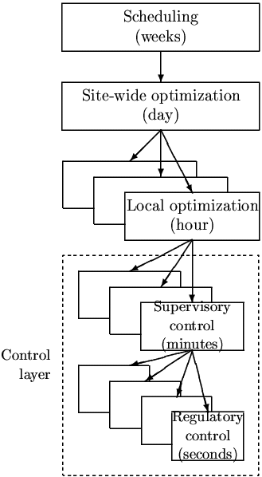
Conclusion and future work
Model development
Controller design for regulatory layer
Design of supervisory control based on economic objective cost
Figure: Sigurd, Computers and Chemical Engineering (2004)
Notes:
Discuss how T_in is now a DOF that will be used for supervisory control layer design
Supervisory layer- Economic objective can be function to minimize deviation from given reference power profile and maximize the H2 production, without violating constraint on maximum current density and allowed electrolyzer operation temperature limits
Controlling temperature using qlyek

